Slide 1

Validation of serological biomarkers for detection of non-alcoholic fatty liver disease (NAFLD) and/or advanced liver fibrosis in people living with HIV
Carolyn Yanavich, Antônio Pacheco, Sandra W Cardoso, Estevão Portela, Ursula B Chaves, Ricardo Santos, Michelle Morata, Valdilea G Veloso, Beatriz Grinsztejn, Hugo Perazzo
National Institute of Infectious Diseases Evandro Chagas (INI)
Oswaldo Cruz Foundation (FIOCRUZ)
Rio de Janeiro - Brazil
Session: Co-morbidities: No organ left behind
Abstract MOAB0203 – Monday - July 22th, 2019

Slide 2
Disclosures
The authors have nothing to disclosure

Slide 3
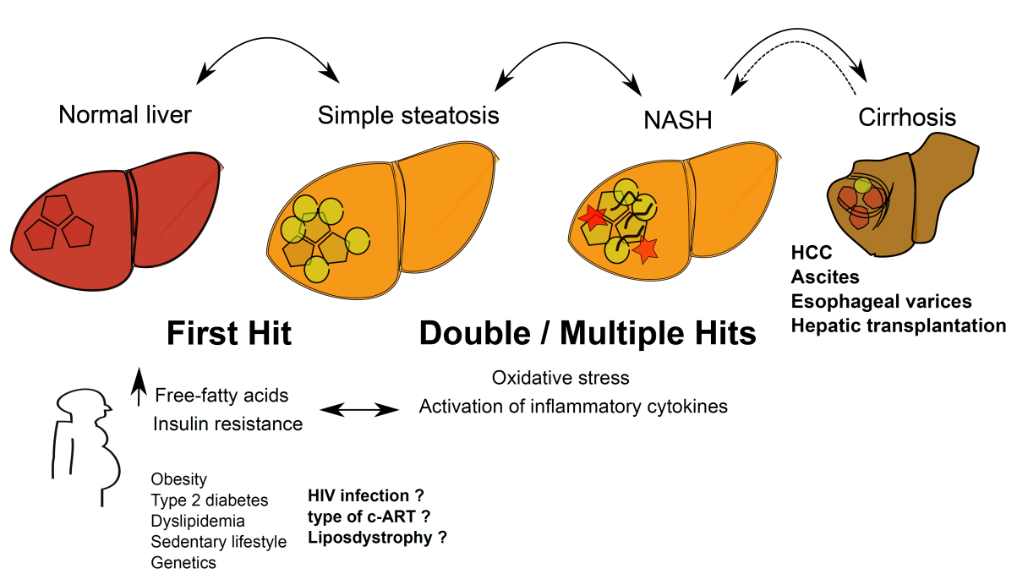
People living with HIV had 2-fold higher odds of liver steatosis compared to paired uninfected individuals
[OR=2.1 (95%CI 1.49-2.95), p<0.001]
NAFLD
Abnormal liver fat accumulation (> 5% of hepatocytes) in absence of abusive alcohol intake
Anthropometric measures
Pacheco, Perazzo, Cardoso et al AIDS conference 2018

Slide 4
Background
Recent studies that estimated the prevalence of steatosis and liver fibrosis in HIV-infected patients using transient elastography (FibroScan)
2011
2016
2019

Slide 5

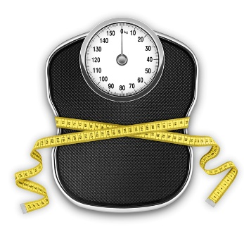
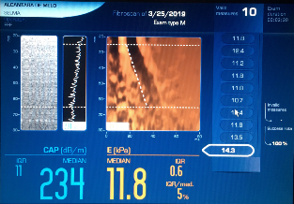
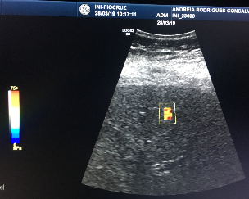
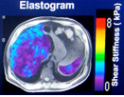

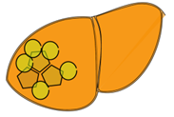

Background
Serological biomarkers
Liver biopsy and imaging
Laboratory results
Liver biopsy
FibroScan / CAP
Anthropometric measures
SWE ultrasound
MRI
Fatty liver
Advanced fibrosis / cirrhosis
Simple parameters
Low cost
Worldwide available
Non-medical personnel
Ela

Slide 6




Tests for detection of NAFLD
Biomarker | Parameters and mathematical formula
Fatty Liver Index (FLI) Bedogni 2006 | BMI, waist circumference (WC), GGT, triglycerides FLI ≥ 60 (e0.953*ln(triglycerides, mg/dl)+0.139*BMI + 0.718*ln(GGT) + 0.053*ln(WC) - 15.745) x 100 1 + (e0.953*ln(triglycerides, mg/dl)+0.139*BMI + 0.718*ln(GGT) + 0.053*ln(WC) - 15.745)
NAFLD-Liver Fat Score (NAFLD-FLS) Kotronen 2009 | Metabolic syndrome (MS), type-2 diabetes (T2D), insulin, AST, ALT NAFLD-LFS ≥ - 0.640 -2.89 + 1.18 * (MS–Y=1/N=0) + 0.45 * (T2D –Y=1/N=0) + 0.15 * (insulin) + 0.04 * (AST) – 0.94 (AST/ALT)
Hepatic Steatosis Index (HSI) Lee 2010 | AST, ALT, type-2 diabetes and sex at birth HSI ≥36 8 x ALT/AST ratio + BMI + 2 (if T2DM) + 2 (if female)
Steato-ELSA Perazzo 2018 | BMI, waist circumference (WC), triglycerides, insulin, glucose, AST, ALT Steato-ELSA ≥ 0.386
[(0.0823*BMI) + (0.0337*WC) + (0.0596*HOMA-IR) + (0.0036*trig) + (0.0173*ALT) – (0.0124*AST) – 6.6434]
2.17828
[(0.0823*BMI) + (0.0337*WC) + (0.0596*HOMA-IR) + (0.0036*trig) + (0.0173*ALT) – (0.0124*AST) – 6.6434]
1 + 2.17828

Slide 7





Tests for detection of advanced fibrosis
(F3F4 METAVIR)
Biomarker | Parameters and mathematical formula
Aspartate-to-Platelet Ratio Index (APRI) Wai 2003 | AST, platelet count APRI ≥ 1.5 AST (/ULN) x 100 Platelet count
Fibrosis-4 score (FIB-4) Vallet-Pichard 2007 | Age, AST, ALT, platelet count FIB-4 ≥ 3.25 Age * AST (UI/L) x 100 Platelet count * sqrt[ALT(UI/L)]
NAFLD Fibrosis Score (NFS) Angulo 2010 | Age, BMI, type-2 diabetes (T2D), AST, ALT, platelet count, albumin NFS ≥ 0.676 1.675 + 0.037 * age + 0.094 * BMI + 1.13 * T2D (Y=1/N=0) + 0.99 * AST/ALT – 0.013 * platelet count – 0.66 * albumin

Slide 8
Aims
To validate the accuracy of serological biomarkers to detect NAFLD and advanced fibrosis in HIV mono-infected patients

Slide 9
Methods
PROSPEC-HIV study (NCT 02542020)
  Longitudinal cohort of 720 HIV patients have been evaluated by FibroScan ® (Echosens, France) at INI-FIOCRUZ since June 2015
Study design
  Cross-sectional analysis of the PROSPEC-HIV study (baseline)
Inclusion criteria
  HIV infection
Exclusion criteria
  Viral hepatitis co-infection
  Abusive alcohol intake [AUDIT > 8]
  Missing data for serological biomarkers
  Unreliable transient elastography (FibroScan)

Slide 10
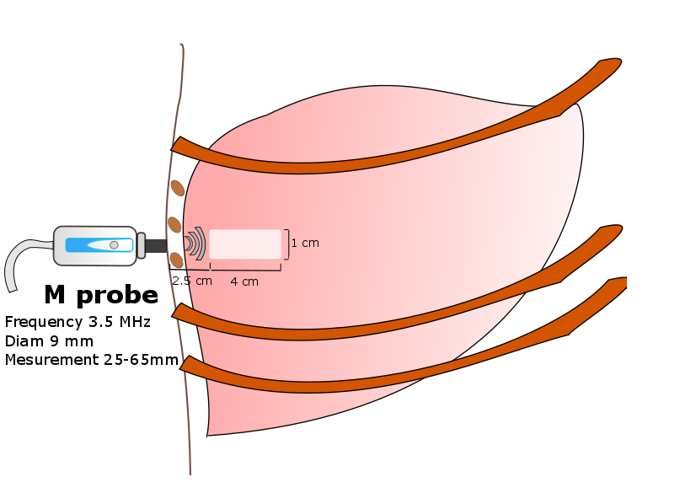
Methods
Performed on the same day (fasting status)
Clinical evaluation: anthropometric measures, alcohol intake (AUDIT score), co-morbidities and co-medication use, history of HIV infection and c-ART treatment
Blood sample
Transient elastography by FibroScan ®
Parameter | Assessment | Cut-offs
Liver stiffness measurement (LSM) | Fibrosis (F≥3 METAVIR) | ≥ 8.7 kPa for M probe † ≥ 7.2 kPa for XL probe †
Controlled Attenuation Parameter (CAP) | Steatosis ≥ 5% (hepatocytes) | ≥ 248 dB/m §
Reliable FibroScan
10 valid measures
IQR/LSM < 30% / IQR/CAP < 30%
Success rate ≥ 60%
† Wong et al Am J Gastro 2012 / § Karlas et al J Hepatol 2017

Slide 11
Methods
Serological biomarkers were calculated according to the original publication
Outcomes
  NAFLD (CAP ≥ 248 dB/m ) in reliable CAP measures
  Advanced fibrosis (LSM ≥ 8.7 kPa / 7.2 kPa) in reliable LSM
AUROC; sensitivity, specificity; positive predictive value (PPV); negative predictive value (NPV) and likelihood ratios
STATA software (2017; StataCorp LP, TX, USA)

Slide 12
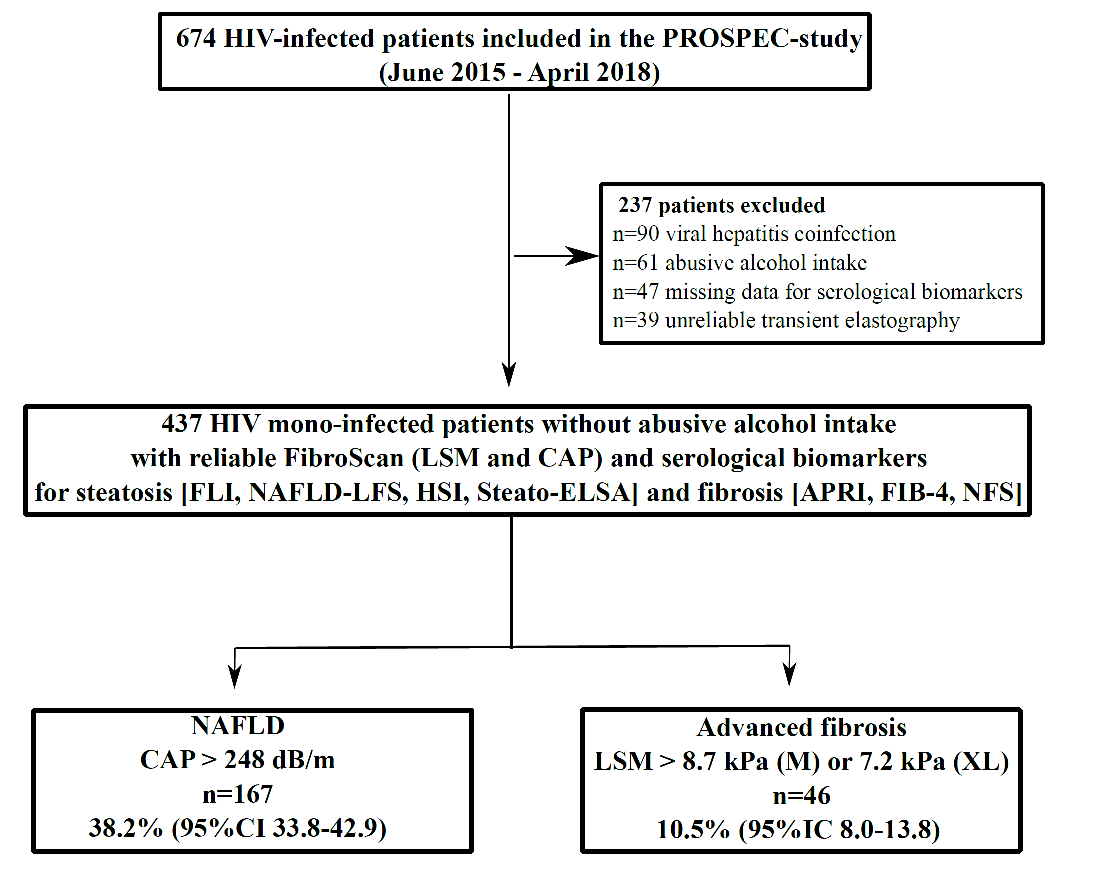
Flow-chart of the study

Slide 13
Results
Baseline characteristics of patients
 | All (n=437)
Female gender | 249 (57%)
Age, years | 44 [35-52]
Black/Mixed skin color | 228 (52%)
Former or current smoking | 184 (42%)
Metabolic features
BMI, Kg/m² | 26.1 [23.4-29.3]
Waist circumference, cm | 91 [84-99]
Metabolic syndrome | 154 (35%)
HOMA-IR | 2.48 [1.68-3.94]
Biochemistry
ALT, IU/L | 30 [23-43]
AST, IU/L | 25 [20-33]
GGT, IU/L | 46 [32-75]
Fasting glucose, mg/dL | 94 [88-101]
Fasting insulin, mmol/L | 10.7 [7.6-16.1]
Triglycerides, mg/dL | 124 [84-178]
HIV infection
c-ART | 420 (96%)
Duration of c-ART, years | 7.2 [3.8-13.8]
CD4 count (cells/mm3) | 620 [427-901]
HIV viral load > 40 copies/mm3 | 80 (18%)
Nadir CD4 < 100 cells/mm3) | 197 [84-323]
Data expressed as n (%) or median [IQR]

Slide 14
Biomarkers of NAFLD (n=437)
Fatty Liver Index
NAFLD Liver Fat Score
p < 0.001
p < 0.001
79
36
0.867
- 1.035
(n=270)
(n=167)
Hepatic Steatosis Index
(n=270)
(n=167)
Steato-ELSA
p < 0.001
p < 0.001
0.589
42
35
0.283
(n=270)
(n=167)
(n=270)
(n=167)

Slide 15
AUROCs of serological biomarkers for detection of NAFLD

Slide 16
Biomarkers of fibrosis (n=437)
FIB-4
APRI
p < 0.001
p < 0.001
1.21
0.41
0.79
0.28
(n=391)
(n=46)
(n=391)
(n=46)
NAFLD Fibrosis Score
p < 0.001
-0.581
-2.388
(n=391)
(n=46)

Slide 17
AUROCs of serological biomarkers for detection
of advanced fibrosis (METAVIR F3F4)

Slide 18
Diagnostic value of serological biomarkers for diagnosis of NAFLD and/or advanced fibrosis
 | Sensitivity [95%CI] | Specificity [95%CI] | PPV | NPV | LR+ | LR+
Biomarkers for diagnosis of NAFLD
Steato-ELSA ≥ 0.386 | 81% [76-87] | 74% [69-80] | 66% | 87% | 3.19 | 0.25
FLI ≥ 60 | 75% [69-82] | 76 % [70-81] | 65% | 83% | 3.09 | 0.32
HSI ≥ 36 | 89% [84-93] | 52% [46-58] | 53% | 88% | 1.84 | 0.22
NAFLD-LFS ≥ -0.640 | 80% [74-86] | 63% [57-69] | 57% | 84% | 2.17 | 0.31
Biomarkers for diagnosis of advanced fibrosis (METAVIR F3F4)
FIB-4 ≥ 3.25 | 4% [0-10] | 99% [98-100] | 50% | 90% | 8.50 | 0.96
APRI ≥ 1.5 | 2% [0-6] | 99% [98-100] | 25% | 90% | 2.93 | 0.99
NFS ≥ 0.676 | 11% [2-20] | 98% [97-99] | 38% | 90% | 5.31 | 0.91
FLI, Fatty Liver Index
HSI, Hepatic Steatosis Index
NAFLD-LFS, NAFLD Liver Fat Score
FIB-4, Fibrosis-4 Score
APRI, Aspartate-to-Platelet Ratio Index
NFS, NAFLD Fibrosis Score
PPV, positive predictive value
PPV, negative predictive value
LR+, positive likelyhood
LR-, negative likelyhood

Slide 19
Limits & Strengths
Limitations
  Lack of a more robust gold-standard for NAFLD (MRI-PDFF) and advanced liver fibrosis (liver biopsy)
Strengths
  Large sample size
  Centralized laboratory for blood parameters
  FibroScan was performed by a single experimented operator on the same day of blood sample

Slide 20
Conclusions
In mono-infected HIV patients without abusive alcohol intake:
  Serological biomarkers had a good accuracy for detection of NAFLD, especially Fatty Liver Index and Steato-ELSA
  Serological biomarkers for fibrosis yielded a high specificity and negative predictive value for advanced fibrosis (METAVIR F3F4)
  These tests should be integrated to HIV care to detect NAFLD and to exclude advanced liver fibrosis

Slide 21




Acknowledgements
Participants of the study
Colleagues from LAPCLIN-AIDS at INI-FIOCRUZ
Agencies that have been supporting the PROSPEC study
Thank you for your attention

